Slide 1

Overview of
Conflict Management in the Workplace
Presented by:
Steve Evans FBII.tp

Slide 2


Steve Evans FBII.tp
Regional Representative
East of England
Regional Vice-chairman - East of England
Member of National Mentoring Team
BIIAB Trainer

Slide 3
Objectives
To present a structure around dealing with conflict situations that may occur on Licensed Premises.
To be both relevant as a refresher for professionals ,
as well as a focused tool to take away and present to Hospitality Staff at all levels.
Helping to build confidence and improve Personal Safety.

Slide 4
Agenda
Identifying a potential problem
Dynamic Risk Assessment
Initiate your plan
Options and Resources
Transference of evidence and intelligence

Slide 5
Identifying a problem
Joint Initiative (forming a group)
Raised voice, swearing and argumentative
Threats
Reddening and distortion of the face
Aggressive stance and gestures (clenched fists)
Trying to involve others

Slide 6
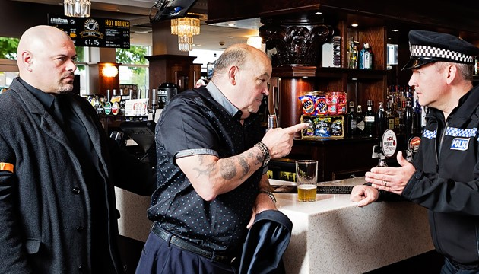
Scenario

Slide 7
Dynamic Risk Assessment
P Person
Do you know their history?
How do they appear – Under the influence or Mental Health?
Physical capability and are they alone or with others?
O Object
Is there an object in the persons possession or a nearby item that could be used as a weapon?
P Place
Can I get away?
What hazards are there? – Stairs? Isolated areas? etc.
Am I covered by CCTV?
Using the P.O.P model you make the assessment process a
conscious dynamic act
.

Slide 8
Initiate your plan
S Step Back
A Assess the Threat
F Find Help
E Evaluate the Options
R Respond using the best Option

Slide 9
Transference of
Evidence and Intelligence
Incident Log
CCTV in presentable format
Preserve any items for Forensic Examination
Witness details – for statement purposes
Police Liaison
Report via Pub Watch and (if applicable) apply to Committee for a ban

Slide 10

Summary
    Identifying a potential problem
    Dynamic Risk Assessment
    Initiate your plan
    Options and Resources
    Transference of evidence and intelligence

Slide 11
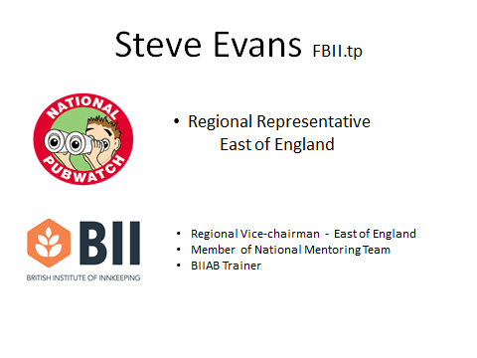
Details of BII Membership Benefits are available on the web-site: www.bii.org.uk
For National Pub Watch and BII information
for the East of England Region
please contact me
M: 07413961953 | T: (01707) 552145
e-mail: stephen.evans@nationalpubwatch.org.uk

