Slide 1
Safeguarding:
Security making people and places safer
Ed Bateman
Deputy Director
Partnerships and Interventions

Slide 2
SIA - who are we?
Public Body – sponsored by the Home Office
Regulation of certain activities within the security industry
Support the key priorities of the Home Office
  Public protection
  Reduction and prevention of crime
Whole UK remit
Set and approve standards of training
License individual operatives
Maintain a (voluntary) register of approved providers of security industry services - ACS

Slide 3
The SIA in numbers
382,377 licenses held by 339,940 people
  Door Supervisors 55%
  Security Guarding 23%
  CCTV 13%
  Close Protection 4%
Over 1,430,000 licenses issues since 2004
46,000 licenses revoked; 36,000 refused
5000 intelligence feeds each year
Approximately 4000 businesses in licensable sectors
838 businesses Approved Contractor Status (ACS)
98% (random check) licence compliance
Notes:
98% compliance
Over 90% businesses alarm clock goes off and they get out of bed to do a really good job
Remaining 10%, some just don’t have good standards (and we work with them to make better) but only a very small percentage, probably under 3% , are intentionally committing PSIA offences or, worst, involved in serious and organised crime.
46,000 licenses revoked; 36,000 refused
1500 revocations relate to immediate threat to public safety
Work very closely with police to remove licenses from those that cause risk to the public
And…..
1000 premises visited
300 compliance cases
30 criminal investigation = 15-20 prosecutions

Slide 4
Partnerships - licensing
Raising Standards and Protecting the Public
Licence holders
Assessment and accreditation bodies
Trade associations
Businesses
SIA
Buyers

Slide 5
Partnerships - enforcement
Raising Standards and Protecting the Public
Information sharing
Police
National Crime Agency
HMRC
Immigration Enforcement
GAIN

Slide 6
Safeguarding
SIA used to do licensing and enforcement…….
The transition from the industry being part of the problem to an industry being part of the solution
  Child Sexual Exploitation
  Terrorism
  Modern Day Slavery
  Serious and Organised Crime
  Violence in the night time economy and across guarding generally
  Vulnerability

Slide 7
Child Sexual Exploitation (CSE)
Messages:
Your licensed operatives work in the environments where CSE occurs
Refer to and be aware of the indicators of child sexual exploitation
Know how to report it when approached for advice by your licensed operatives

Slide 8
Counter-Terrorism (CT)
Messages:
The security industry has a vital role to play in remaining alert to suspicious or unusual behaviour at or near crowded places or critical infrastructure
Businesses must know how to report suspicious behaviour when approached by licensed operatives with information
Businesses should consider attending Project Griffin training and encouraging buyers and owners of secured infrastructure to engage with Project Argus.
Visit our website regularly to get partner agency CT updates

Slide 9
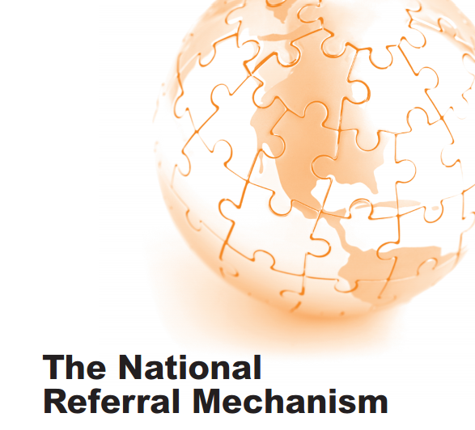
Modern Day Slavery
Messages:
Modern Day Slavery (conscious and persistent exploitation of workers) is happening somewhere in the UK today in relation to our industry
If you are tendering for or take over a contract where you consider this has happened or is happening, please report it through the NRM

Slide 10
Serious and Organised Crime
Messages:
If you consider that lifestyle criminals are behind a local business, report the intelligence to an SIA investigator, Crimestoppers or through the SIA website reporting portal
The SIA work with police, HMRC and other agencies and successfully disrupt, frustrate and neutralise organised crime groups exploiting the security industry
Working with police, we have been instrumental in removing multi million £ contracts from criminal controlled businesses redistributing contracts to ACS companies

Slide 11
Violence Reduction
Messages
SIA regional teams work closely with police and other partners to reduce violence associated with licensed premises in city and town centres
Regional workshops changing perceptions of and between police and door supervisors
Changing profile of violence – equally daytime
Significant under reporting of violence against door supervisors – cultural?
The SIA is developing a Violence Reduction good practice register on their website including case studies of what works and initiative contact points.

Slide 12
Vulnerability
Messages:
Vera Baird and Newcastle
Assaults – often several opportunities missed
Not just women
Loads of initiatives
  Ask for Angela
Jigsaw of agencies: Police, SIA, street pastors, taxi marshals, safe havens, door supervisors, street wardens, Town Centre Managers, street briefings, Business Crime Reduction Partnerships (radios)

Slide 13
Safeguarding
Getting the messages across
CT and vulnerability are part of the training syllabus
Roll out of Griffin and Argos
Regional investigators set targets for visiting businesses to discuss safeguarding
Information and links on SIA website
Good businesses provide additional training
Police working closely with local venues
NaCTSO – Crowded Places Guidebook
Challenges:
  Growth of Door Supervisor responsibilities and upskilling as role casualising?
  Getting the safeguarding messages to the ‘hard to reach’

Slide 14
Safeguarding:
Security making people and places safer
Ed Bateman
Deputy Director
Partnerships and Interventions

