Slide 1
Pubwatch Legal round-up
Gary Grant
Barrister
FRANCIS TAYLOR BUILDING
www.ftb.eu.com
Vice-Chairman
Institute of Licensing
www.instituteoflicensing.org
13th National Pubwatch Conference
February 2016
Notes:
Keep presentations right up to date

Slide 2
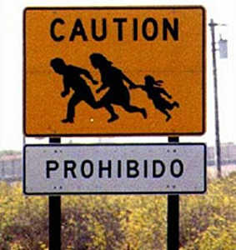
ILLEGAL WORKERS

Slide 3
ILLEGAL WORKERS
R(Aryubi) v Birmingham City Council [2015] EWHC 1972
Market Traders in Bull Ring Market arrested – illegal workers
Birmingham City Council – terminated stall-holders’ licences (Reg 10 of Retail Markets Regulations 2006 – “incident of serious misconduct” ).
Quashed by High Court – for procedural errors

Slide 4
ILLEGAL WORKERS
Reviews of Premises Licence under Licensing Act 2003
S.182 Guidance (para 11.27): “There is certain criminal activity that may arise in connection with licensed premises which should be treated particularly seriously… [These include:] knowingly employing a person who is unlawfully in the UK or who cannot lawfully be employed as a result of a condition on that person’s leave to enter”

Slide 5
ILLEGAL WORKERS
[11.28] “It is envisaged that licensing authorities, the police and other law enforcement agencies, which are responsible authorities, will use the review procedures effectively to deter such activities and crime. Where reviews arise and the licensing authority determines that the crime prevention objective is being undermined through the premises being used to further crimes, it is expected that revocation of the licence – even in the first instance – should be seriously considered.”

Slide 6
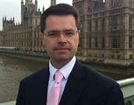
ILLEGAL WORKERS
Impact of Immigration Bill 2015 (published 17.9.15)
James Brokenshire MP, Immigration Minister:
“Rogue employers will feel the full force of Government machinery … undocumented workers will face the prospect of a prison term”

Slide 7
ILLEGAL WORKERS
Offence of employing a worker “knowing or having reasonable cause to believe” no right to work in UK
Increase in max penalty from 2 to 5 years prison
Sliding scale of punishment if employer reports worker.

Slide 8
ILLEGAL WORKERS
Proposes significant amendments to Licensing Act 2003
Inserts s.192A – defining “entitlement to work in the UK”
Secretary of State becomes a Responsible Authority

Slide 9
ILLEGAL WORKERS
Individual resident in UK may not apply for a Premises Licence unless entitled to work in UK
Premises Licence lapses if holder ceases to be entitled to work in UK

Slide 10
ILLEGAL WORKERS
Transfer applications:
  If applicant resident in UK must be entitled to work in UK
  Secretary of State must be notified and may object to transfer if exceptional circumstances and grant “prejudicial to the prevention of illegal working in licensed premises”

Slide 11
ILLEGAL WORKERS
Interim Authority notice – if resident in UK can only apply if entitled to work in UK & can be cancelled on intervention of Secretary of State

Slide 12
ILLEGAL WORKERS
Personal Licences:
  Only grant if entitled to work
  cease to have effect if holder ceases to be entitled to work in UK
  relevant offence includes immigration offence and immigration penalty
  Sec of State can object

Slide 13
ILLEGAL WORKERS
Illegal Working Closure Notices– if employing illegal workers
Issued by Immigration Officers – prohibits access to premises for up to 24-48 hours (depending on rank of officer)

Slide 14
ILLEGAL WORKERS
Application to Magistrates’ Court for Illegal Working Compliance Order
Various sanctions available from requiring immigration checks to closure of premises for up to 12 months

Slide 15
ILLEGAL WORKERS
Due diligence (includes):
  Obtain the person’s original documents;
  Check them in the presence of the holder; and
  Make and retain a clear copy, and make a record of the date of the check.
  Take particular care over Student Visas (obtain proof of academic term and vacation dates)

Slide 16
ILLEGAL WORKERS
See: “An employer’s guide to acceptable right to work documents” (Home Office, May 2015)
https://www.gov.uk/government/uploads/system/uploads/attachment_data/file/441957/employers_guide_to_acceptable_right_to_work_documents_v5.pdf
See: “An employer’s guide to right to work checks” (Home Office, May 2015)
https://www.gov.uk/government/uploads/system/uploads/attachment_data/file/426964/an_employers_guide_to_right_to_work_checks_may_2015_final.pdf

Slide 17
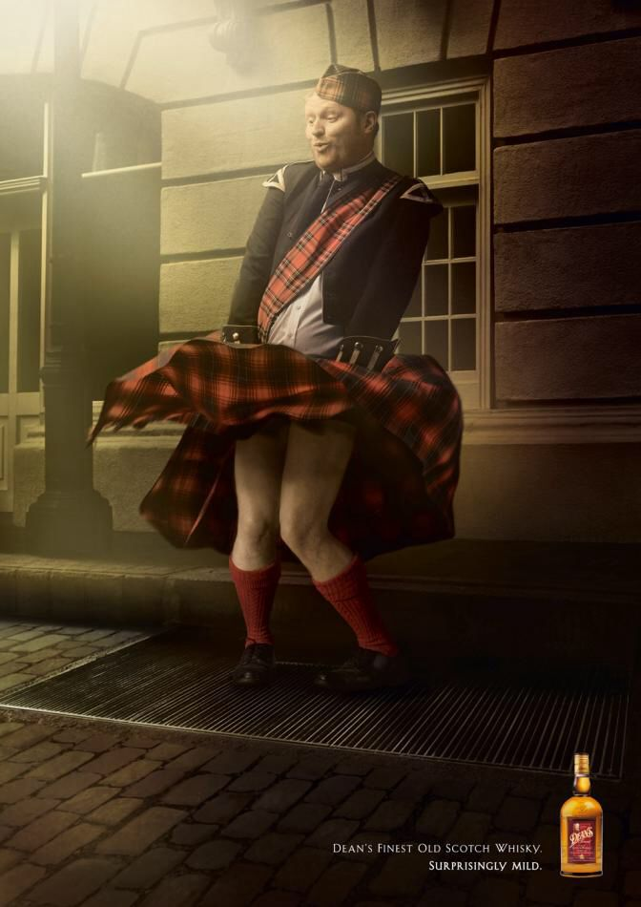
MINIMUM UNIT PRICING
The Scotch Whisky Association
(& Others)
-v-
The Lord Advocate &
The Advocate General for Scotland
ECJ (2nd Ch), C-333/14 (23.12.15)

Slide 18
MINIMUM UNIT PRICING
Alcohol (Minimum Pricing) (Scotland) Act 2012
Alcohol (Minimum Price per Unit) (Scotland) Order 2013 – sets MUP at 50p
Treaty on the Functioning of the European Union (“TFEU”)

Slide 19
MINIMUM UNIT PRICING
Article 34:
“Quantitative restrictions on imports and all measures having equivalent effect shall be prohibited between Member States”.
MUP falls within Art 34

Slide 20
MINIMUM UNIT PRICING
Is MUP rescued by Article 36 ?
Art 36- The provisions of Articles 34 … shall not preclude prohibitions or restrictions on imports, exports or goods in transit justified on grounds of … the protection of health and life … . Such prohibitions or restrictions shall not, however, constitute a means of arbitrary discrimination or a disguised restriction on trade between Member States.

Slide 21
MINIMUM UNIT PRICING
Question of proportionality:
“the national measure must actually meet the objective of the protection of human health and must not go beyond what is necessary in order to attain that objective.”
Could end be achieved by raising duty instead of MUP?

Slide 22
MINIMUM UNIT PRICING
ECJ: The effect of the Scottish legislation is significantly to restrict the market, and this might be avoided by the more proportionate introduction of a tax measure designed to increase the price of alcohol instead of a measure imposing a minimum unit price per unit of alcohol.
Ultimately for national courts to determine on evidence.
Impact on England & Wales?

Slide 23
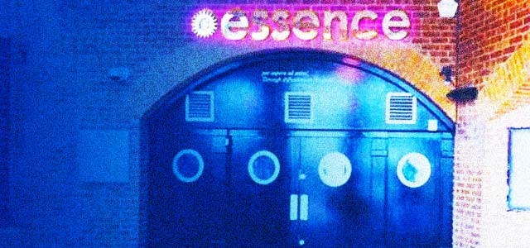
LICENSING APPEALS
The Queen (o.a.o) Essence Bars (London) Ltd –v- Wimbledon Magistrates’ Court and Royal Borough of Kingston upon Thames [2016] EWCA Civ 63 (Crt of Appeal)

Slide 24
LICENSING APPEALS
Appeal by way of Complaint
COMPLAINANT: FL Trading Ltd [c/o solicitor]
RESPONDENT: Royal Borough of Kingston upon Thames
Notice of Appeal
TAKE NOTICE that the Complainant, the premises licence holder of the premises licence for the premises “Essence” [address] intends to appeal … against the decision of the Royal Borough of Kingston upon Thames of 10th January 2014 … revoking the premises licence…

Slide 25
LICENSING APPEALS
Mistake in complaint/notice of appeal as to appellant can only be corrected:
  If “mistake of name” rather than “mistake of identity”; AND, IF FORMER
  Where the other party was not in any reasonable doubt about the identity of the appellant
Essence case remitted to magistrates’ court

Slide 26
LICENSING APPEALS
Probably ends practice of transferring licence to another pending appeal after 21 day time limit for appealing has expired.
Confirms strict compliance with 21 day time limit for appealing.

Slide 27
APPEAL COSTS FOR NON-PARTIES
S 181 Licensing Act 2003 (appeals to magistrates’ court). A court:
“may make such order as to costs as it thinks fit”

Slide 28
APPEAL COSTS FOR NON-PARTIES
General principle : costs awards can be made against non-parties in licensing appeals in “exceptional and appropriate circumstances”
Principle has been applied to “pierce the corporate veil” to impose costs on individuals (even if corporate licence holder)
Principle extended to apply to other residents in a conjoined appeal.

Slide 29
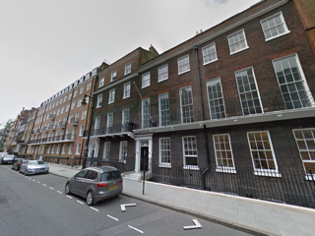
APPEAL COSTS FOR NON-PARTIES
Hill Street Residents v Farm Street Residents (City of London MC, 4.11.15 -see IOL website). District Judge Coleman.

Slide 30
APPEAL COSTS FOR NON-PARTIES
Costs sanctions there to encourage reasonable compromise. DJ Coleman:
“In reality both appeals became part of one court case. Having consented to the joining together of the two appeals, I find there to be an overall responsibility on all parties to the court and to each other, to progress the case, seek to reach a settlement at all times, and prepare efficiently for an effective hearing. The waste of court time caused by last minute settlements at the door of the court is a constant concern in all areas of litigation. I find that I have the power to award costs between the appellants in this case … I find that the failure to reply to correspondence and deal with offers to settle the proceedings does amount to an unnecessary or improper act or omission resulting in the [Farm Street Residents] incurring additional costs. I therefore find it appropriate to exercise my discretion to order costs against [the Hill Street Residents] in favour of the [Farm Street Residents].”

Slide 31
TENS
Increase from 12 to 15 TENS permitted at single premises per year (from 1 January 16).
But other restrictions still apply:
  The total length of all events is not more than 21 days a year
  500 people capacity limit (including staff)
  Each Ten can last no more than 168 hours (7 days)
  Personal licence holder – up to 50 TENS a year
  Non-personal licence holder – up to 5 TENS a year

Slide 32
SUMMARY REVIEWS
Procedures to be significantly amended by Policing and Crime Bill 2016 (clauses 83-84)
Ambiguity on longevity of interim steps pending appeal to be put beyond doubt.
At full review hearing licensing authority can withdraw or modify interim steps to have effect pending appeal.

Slide 33
SUMMARY REVIEWS
Licence holder and police have new right to appeal interim steps (made at full review hearing) to magistrates’ court within 28 days.
Repeated challenges to original interim steps only permitted if “material change of circumstances”

Slide 34
PERSONAL LICENCES
Deregulation Act 2015 – holders of personal licences expiring on or after 1 April 2015 no longer have to apply for renewal.
Requirement to report lost or stolen licences to the police before applying for duplicate abolished from 26.5.15.

Slide 35
PERSONAL LICENCES
Currently personal licence may be suspended or forfeited only by a court on conviction of a “relevant offence” (i.e. listed in Schedule 4 of LA03).
Power to be extended by Policing and Crime Bill 2016 (clauses 85-86)
Licensing authority that granted personal licence to be given similar power to revoke or suspend it for up to 6 months.

Slide 36
PERSONAL LICENCES
Will apply to relevant convictions, foreign offences or immigration offences received at any time before or after the licence was granted (so long as after the date of commencement, i.e. not retrospective).
LA cannot take action if appeal against conviction pending
If LA considering whether to suspend/revoke – licence holder may “make representations” (presumably in writing?)

Slide 37
PERSONAL LICENCES
If LA provisionally decides not to revoke licence – police put on notice and police may then make representations.
Licence holder has right of appeal to magistrates’ court against revocation or suspension of personal licence (licence continues pending appeal)

Slide 38
DEFINITION OF ALCOHOL
S.191 of the Licensing Act 2003 to define alcohol as: “spirits, wine, beer, cider or any other fermented, distilled or spirituous liquor (in any state)”
To make it clear that powdered alcohol and vaporised alcohol are to be regulated in same way as liquid alcohol.
See Policing and Crime Bill 2016 (clause 82)

Slide 39


BINGO IN PUBS
-vs-
The Gambling Commission –v- Greene King Brewing and Retailing Ltd [2006] UKUT 0050 (AAC) (Upper Tribunal, 29.1.16 Judge H Levenson)

Slide 40
BINGO IN PUBS
Alcohol licence under Licensing Act 2003 permits limited bingo in pubs:
  Max stake of £5
  No fee may be charged for playing the game
  Operator may not make any deductions from stake or winnings
  No linking with other premises to provide bigger games with larger prizes
  High-turnover rule – aggregate of stakes or prizes must not exceed £2000 over 7 days

Slide 41
BINGO IN PUBS
If Gambling Commission grants a bingo operating licence:
  High Turnover rule does not apply
  But other restrictions do … unless a premises licence is granted by local authority under Gambling Act 2005

Slide 42
BINGO IN PUBS
If premises licence granted – all restrictions removed.
Similarly, an alcohol licence entitles premises to 2 gaming machines :
  restricted to £1 stake and max £100 prize (ie Category C and D machines)

Slide 43
BINGO IN PUBS
But a Bingo Premises Licence – permits:
  unlimited number of Cat C and D machines
  PLUS,
  Further machines (up to 20% of total) with max. stake of £2 and max. prize of £400 (Cat B4) or £500 (Cat B3).
“Gaming machines are lucrative”

Slide 44
BINGO IN PUBS
Greene King applied to Gambling Commission for bingo operator’s licence.
Greene King satisfied GC “as to the suitability and competence of the [company]… to offer the proposed licensable activities”.
But GC refused to grant Greene King their operator’s licence – on policy grounds (preventing Greene King applying for premises licences).

Slide 45
BINGO IN PUBS
Greene King won appeal to First Tier Tribunal - GC had trespassed impermissibly on the territory of local authorities to decide what premises to grant licences to.
“If bingo halls can offer alcohol why can’t pubs offer bingo?”
But Gambling Commission won in Upper Tribunal

Slide 46
BINGO IN PUBS
GC argued: The issue was whether the proposal to provide high stake and prizes commercial gambling as an ancillary attraction in alcohol-led non-bespoke gambling premises was consistent with the licensing objectives.
Upper Tribunal ruled GC could, as a matter of law, make a decision on whether to grant an operator’s licence based on these wider policy grounds

Slide 47
BINGO IN PUBS
Case remitted to First-Tier Tribunal to re-consider the decision of the GC on its merits.

Slide 48
ALCOHOL WHOLESALER REGISTRATION SCHEME
Scheme introduced to tackle alcohol fraud – “white van man”
If you sell alcohol to another business – need to register for the AWRS (between 1.1.16 – 31.3.16)

Slide 49
ALCOHOL WHOLESALER REGISTRATION SCHEME
From 1 April 2017 - if you buy alcohol from a UK wholesaler – need to check the seller has registered with HMRC and has an AWRS Unique Reference Number.
Online register

Slide 50
ALCOHOL WHOLESALER REGISTRATION SCHEME
Exclusions:
  Traders who are mainly retailers, but unknowingly or unintentionally make occasional trade sales (“incidental sales”)
  Wholesale sales of alcohol between members of the same corporate group

Slide 51
DE-REGULATION OF ENTERTAINMENT
From 1 April 2015 (most importantly) no specific authorisation required for providing live or recorded music if:
it takes place between 8AM and 11PM; and
it takes place at an alcohol on-licensed premises; and
And the audience is no more than 500 people

Slide 52
DE-REGULATION OF ENTERTAINMENT
Also, you don’t need a licence:
  to put on unamplified live music at any place between 8am-11pm; or
  to put on amplified live music at a workplace between the same hours and provided the audience is no more than 500 people.

Slide 53
DE-REGULATION OF ENTERTAINMENT
Any conditions on premises licence applying to regulated entertainment do not have effect 8am-11pm
For fuller details see Chapter 15 of S.182 Secretary of State’s Guidance to the Licensing Act 2003 (March 2015)
https://www.gov.uk/government/uploads/system/uploads/attachment_data/file/418114/182-Guidance2015.pdf

Slide 54
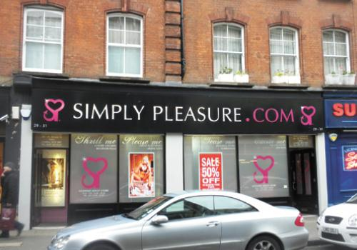
HEMMING - FEES
R (Hemming t/a Simply Pleasure Ltd & Others) v Westminster City Council (and others intervening), [2015] UKSC 25

Slide 55

HEMMING - FEES
Off to European Court of Justice…

Slide 56

Further information:
Gary Grant
Barrister
FRANCIS TAYLOR BUILDING
www.ftb.eu.com
www.licensingbarrister.com
gary.grant@ftb.eu.com
0207 353 8415

