Slide 1


Dealing with vulnerability in the Evening and Night-Time Economy

Slide 2
Who are we?
Chris Stevens Licensing Officer Northamptonshire Police
Jo Cox-Brown

Slide 3
Economic Value of the ENTE
National
  £66 billion revenue (growing 20% YOY)
City Perspective
    ENTE accounts for 27% of town and city centre turnover
      Manchester/Birmingham ENTE - £6 billion
      Edinburgh £4 billion
      Nottingham £3 billion
ENTE is likely to see the biggest economic growth due to the 24/7 economy. With retail, culture, alternative provision for entertainment and heritage the biggest growth drivers. Volume alcohol consumption is down 20% YOY, drugs is increasing

Slide 4
Jobs
Account for between 5-10% of most locations’ overall employment figure
  1.3 million jobs UK
  Employing over 15,000 people
75% of jobs in the ENTE are entry level and held by 18-25’s
  Zero hour contracts
Europe – Half of workers are from outside UK
  55% of jobs are filled by migrant workers
  45% coming from EU countries
The sector will need to recruit 1.3 million staff by 2024.
  Most challenging are front of house (reported by 54% of employers with hard-to-fill vacancies) and chefs (42%)

Slide 5
A challenging and changing landscape
Police Perspective
Culture of tolerance for lower level sexual offending in the NTE
Increase in reported sexual violence
National rise in crime, particularly violent crime in NTE
Increased burden of alcohol related harm impacting on Police and Urgent care units
Paradigm shift in the way vulnerability in NTE is viewed
Focus on reducing the risks
Partnership working and joined up approach is a critical requirement for dealing with vulnerability
Preloading and the presence of intoxicated people in NTE before they enter premises.
Budget constraints for policing leading to reduced number in NTE

Slide 6
Street level vulnerability support

Slide 7
NTE Partnership working
Local Government
Police
City/County Council
Mayors or PCC Office
Hospital (A&E)
Ambulance Service
Fire and Rescue
Drugs/Alcohol – Public Health
Community Alcohol Partnerships
Voluntary Sector
Street Pastors
Street Angels
Homeless
Residents Association
Safe Space
Youth outreach
Drugs and Alcohol
Education
Universities
Student Unions
Accommodation Providers
Higher Education
Sixth forms
Business
Licensed trade
BID
Pubwatch
Licensing networks
Transport providers
PR company

Slide 8
Champions of
Purple Flag
Best Bar None
Pub Watch
CAP
Drink Aware
Data sharing

Slide 9
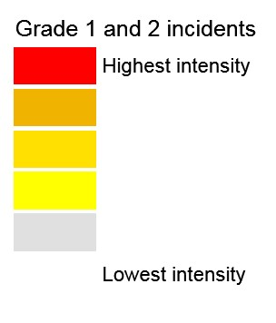
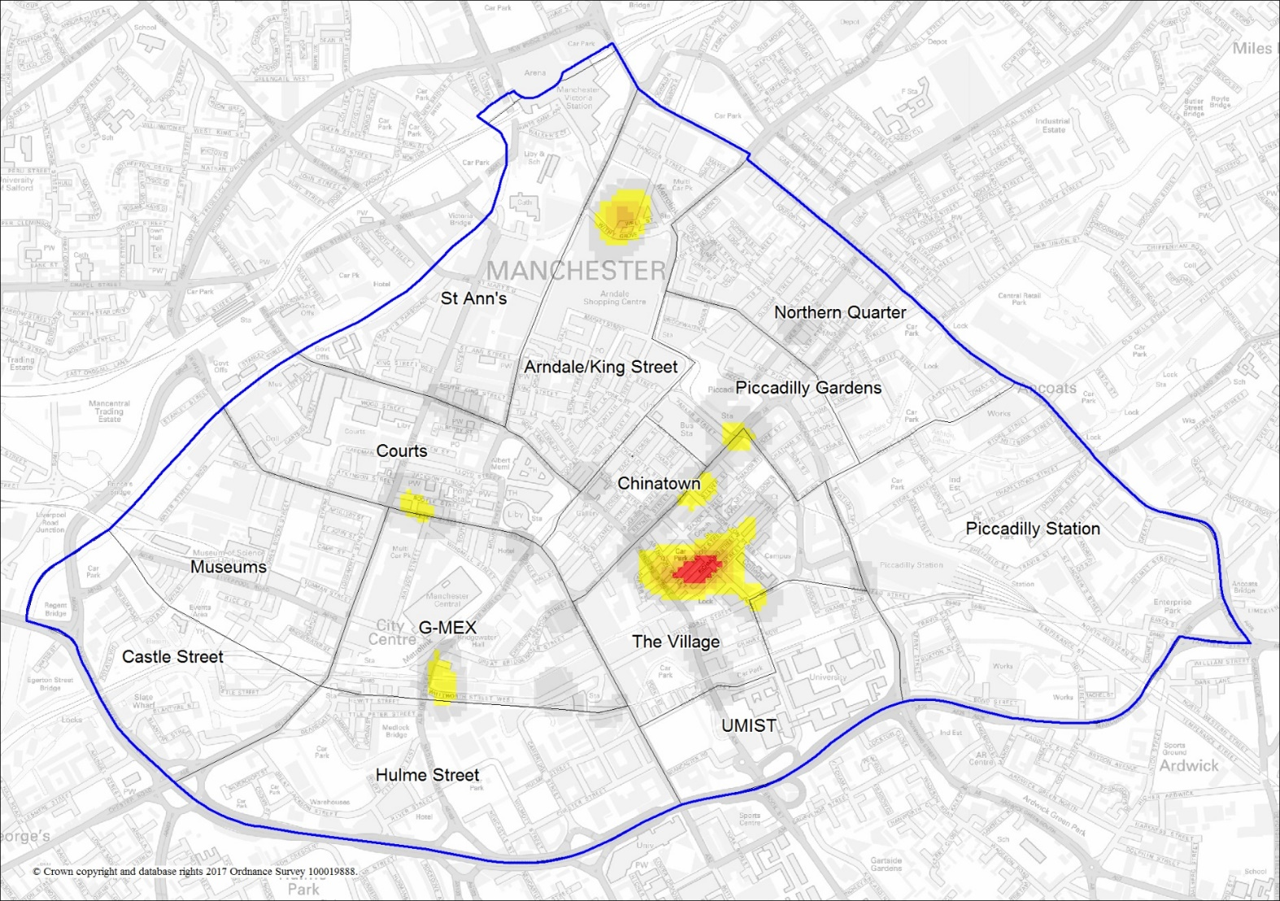
Hot Spot Mapping
Day by day
Hour by hour
Crime type
Ambulance call out

Slide 10
Street Pastors/Angels
WHO/WHAT THEY ARE
Christian voluntary groups
Work set hours
Undertake over 30 hours of training
Usually DBS checked
Normally share anonymised data with ENTE partners

Slide 11
Street Pastors/Angels
WHAT THEY DO
Provide first aid, reducing the burden on emergency services
Care for people who are intoxicated until sober enough to go home
Giving brief interventions on drugs and sexual health
Prevent people becoming victims of crime
Give out supplies such as lollipops to reduce noise, flip flops to prevent cut feet, water to hydrate people, pee pouches to prevent on-street urination and spikeys to detect drink spiking

Slide 12
Street Pastors/Angels
IMPACT
450 groups in the UK, helping an estimated 15 people each night
On average, they prevent 80% of people they help from needing support from A&E, paramedics or police
Analysis in 2015 in Nottingham indicated that every £1 spent on Street Pastors saved £121.50 in emergency services
The friendly, uniformed presence on the streets is also invaluable

Slide 13
Night Owls
WHO/WHAT THEY ARE
Student-led replica of Street Pastors/Angels
Operate in 5 university towns currently
Operate on busy midweek student nights

Slide 14
Night Owls
WHAT THEY DO
Hand out supplies similar to those offered by Street Pastors, as well as condoms
Help vulnerable people to get home safely
Administer first aid
Pick up litter, glass etc.
Provide positive student peer support

Slide 15
Night Owls
IMPACT (1st year figures from Nottingham scheme)
Picked up 1,226 glass bottles and 4,135 items of litter
Walked 179 lone students home
Cared for 194 students who were vomiting or required minor first aid
Provided significant pastoral care to 1,173 students

Slide 16
Volunteer Led Projects
Pros
Relatively low cost
Local people engaged
Extra uniformed visibility
Additional skill set
Reduces pressure on emergency services
Universally well received
Good local support
Attract external funding/sponsorship
Cons
Requires a certain skill set to manage well
Some have low numbers
Not free - does require long-term consistent support/funding
A lot of work to set up and sustain
Requires open and supportive partnership working

Slide 17
Safe Spaces/SOS Buses/Welfare
Centres/Alcohol Treatment Centres
WHO/WHAT THEY ARE
45 Safe Spaces across the UK
Partnership schemes often run by a combination of volunteers, paid staff, St John’s Ambulance, paramedics and hospitals according to local need
Based in buses, cabins, trailers, buildings or hospitals
Portman Group has identified that a total of 150 cities could benefit from a Safe Space, i.e. over 100 more

Slide 18
Safe Spaces/SOS Buses/Welfare
Centres/Alcohol Treatment Centres
WHAT THEY DO
Provide a place of safety, medical assessment & basic treatment, first aid, supervised recovery
Treat injuries, intoxication (alcohol/drugs) and/or are vulnerable for other reasons
Provide advice to those who are lost or can’t get themselves home or have a need for pastoral care
Some signpost users to follow-on services, such as alcohol, drugs and mental health interventions, or services for rough sleepers
Some act as a base for partners managing the local night-time economy

Slide 19
Safe Spaces/SOS Buses/Welfare
Centres/Alcohol Treatment Centres
IMPACT
See 15-20 people each night
Can help offset public sector costs by up to £9.31 for every £1 spent*
Can allow ambulance and A&E services to redeploy £50k - £1m annually per location*
Longevity and value for money is linked to the mobility of the Safe Space – so that it can move as the nightlife evolves, and can also be strategically located for special occasions e.g. festivals, Freshers Week
*Statistics from MAKE Associates “A Study of ‘Safe Spaces’ in the UK Night-time Economy”, 2017.

Slide 20
Red Thread
WHAT THEY DO
Intervene with young knife crime victims in A&E departments to support young people to break the cycle of violence
Alongside Safer London and Only Connect, runs London Gang Exit, which supports young people to exit gangs

Slide 21
Red Thread
WHO THEY ARE
Youth work charity, over 20 years old
Operate in A&E departments in London, and shortly setting up in Nottingham and Birmingham

Slide 22
Red Thread
IMPACT
Lots of positive feedback about the project, including testimonials from Sadiq Khan and Chief Executive of the Imperial College Healthcare Charity
Redthread are currently working with three separate evaluation teams to evidence their success

Slide 23
Inside Venue vulnerability support

Slide 24
NTE Partnership working
Local Government
Police
City/County Council
Mayors or PCC Office
Hospital (A&E)
Ambulance Service
Fire and Rescue
Drugs/Alcohol – Public Health
Community Alcohol Partnerships
Voluntary Sector
Street Pastors
Street Angels
Homeless
Residents Association
Safe Space
Youth outreach
Drugs and Alcohol
Education
Universities
Student Unions
Accommodation Providers
Higher Education
Sixth forms
Business
Licensed trade
BID
Pubwatch
Licensing networks
Transport providers
PR company

Slide 25
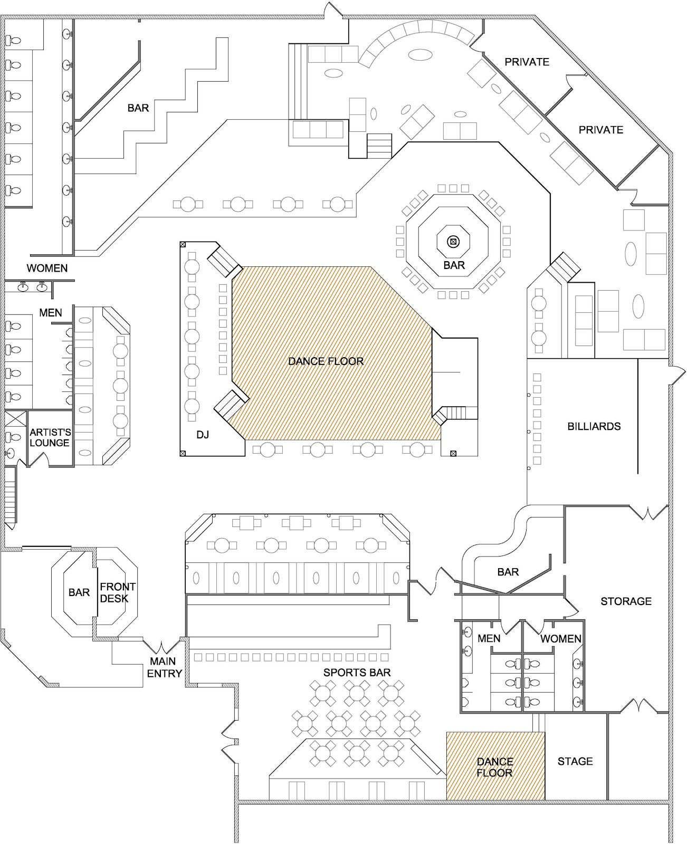
Venue Hot Spot Mapping
Day by day
Hour by hour
Crime type
Ambulance call out

Slide 26
Club Crew/Club Angels/
Welfare Officers
WHO/WHAT THEY ARE
Currently rolled out in 13 cities across the UK
Trained staff or volunteers working in clubs and venues (often in venues with a capacity of over 500)
Work in pairs and wear a highly visible uniform often saying something like “Here to help”
Often funded by a combination of local authority, police, PCC and venue to start with, which increases venue take-up, who then tend to invest in maintaining the scheme long term

Slide 27
Club Crew/Club Angels/
Welfare Officers
WHAT THEY DO
They mingle with customers to promote a positive social atmosphere and help those who may be vulnerable, e.g. too much alcohol
Intervene in potential sexual harassment situations
Reunite lost customers with friends, help people into taxis, or simply provide a shoulder to cry on
Distribute supplies similar to Street Pastors
Coordinate with members of staff like security and first aid, providing an extra layer of support

Slide 28
Club Crew/Club Angels/
Welfare Officers
IMPACT
Drinkaware Crew statistics across all 13 locations:
  Helped 3,634 individuals (2,179 female, 1,455 males)
  Given 1,041 instances of emotional support
  Raised 472 incidents with security staff
  Given 2,001 instances of practical assistance

Slide 29
Drug Testing and Harm
Reduction Advice
WHO THEY ARE
Organisations such as The Loop and Dance Safe
Run by a mixture of paid staff and volunteers and in conjunction with police forces, public health, venues and festival management companies
Testing facilities set up in night clubs, bars or at festivals identify substances of concern that may put users at a greater level of risk
Potential to be run out of Safe Spaces

Slide 30
Drug Testing and Harm
Reduction Advice
WHAT THEY DO
Provide harm reduction advice and information, welfare support, drug safety testing and training
Educate users about drug composition and other harm reduction advice, providing the opportunity for them to make an informed decision as to whether to take the remainder of the drugs
Provide information to revellers and onsite medics of drug-related incidents, so they can provide informed and targeted treatment
Identify substances likely to cause medical issues and communicate to the wider club/festival audience.

Slide 31
Drug Testing and Harm
Reduction Advice
IMPACT
At Boomtown Festival 1,000 recreational drugs were tested resulting in a 25% reduction in drug related referrals to the medical team
Up to 20% of people chose not to take the tested drugs and handed them over for destruction; others took smaller amounts than they would have without the intervention and education
Particularly harmful pills that were being sold at the festival were identified and teams were able to communicate to festival goers not take them, potentially saving lives

Slide 32
Other Opportunities
Training
  Who else? Fast food outlets, venues, transport providers
Unified best practise Policies and reporting across venues
Consistency of approach and offer

Slide 33
Northamptonshire Perspective

Slide 34
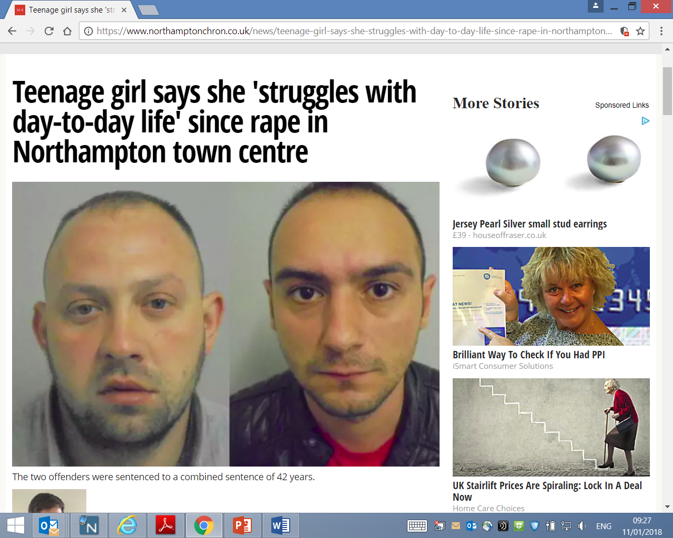
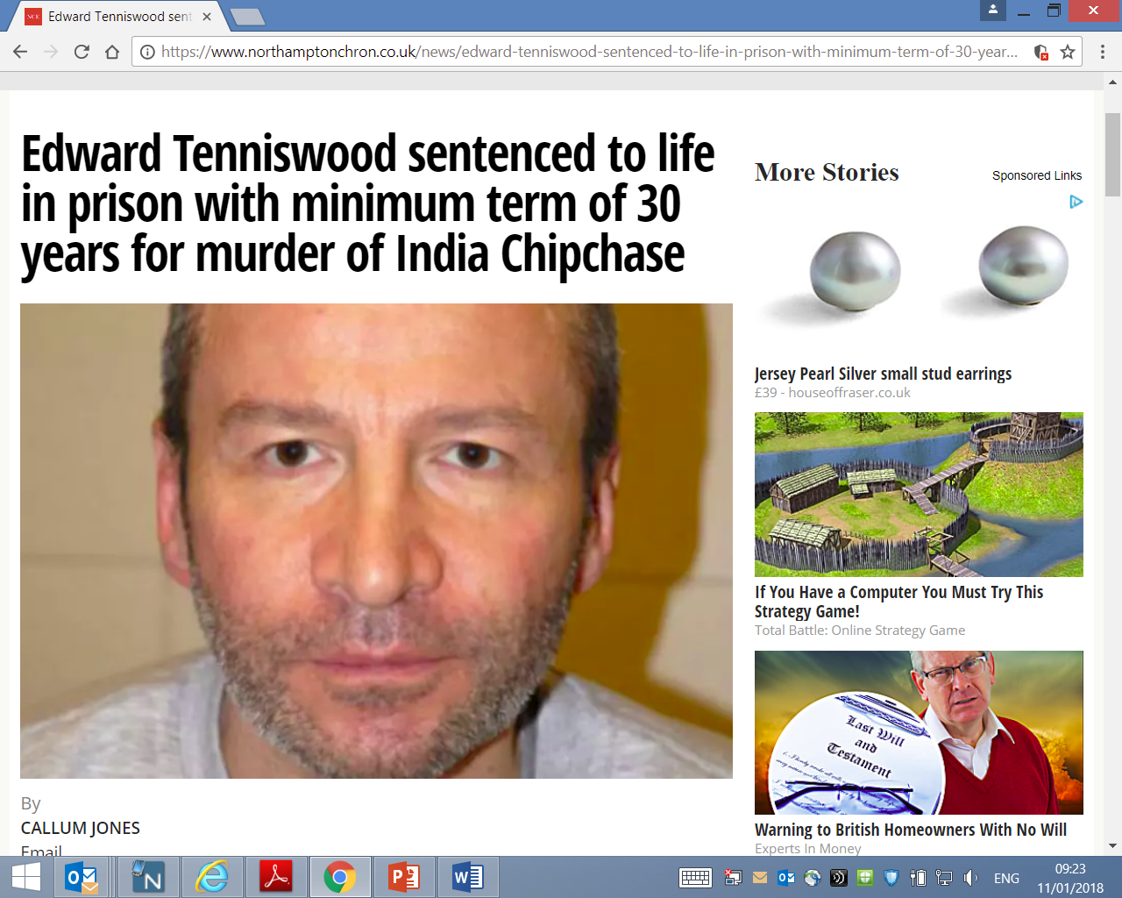
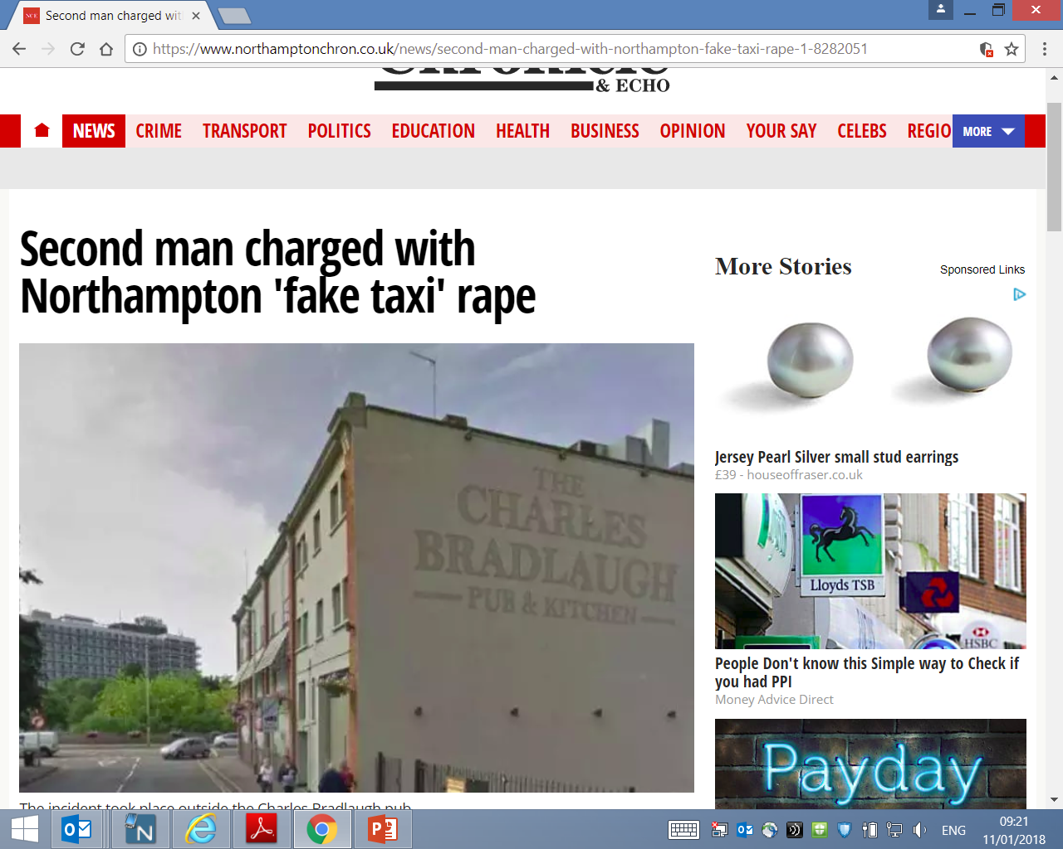
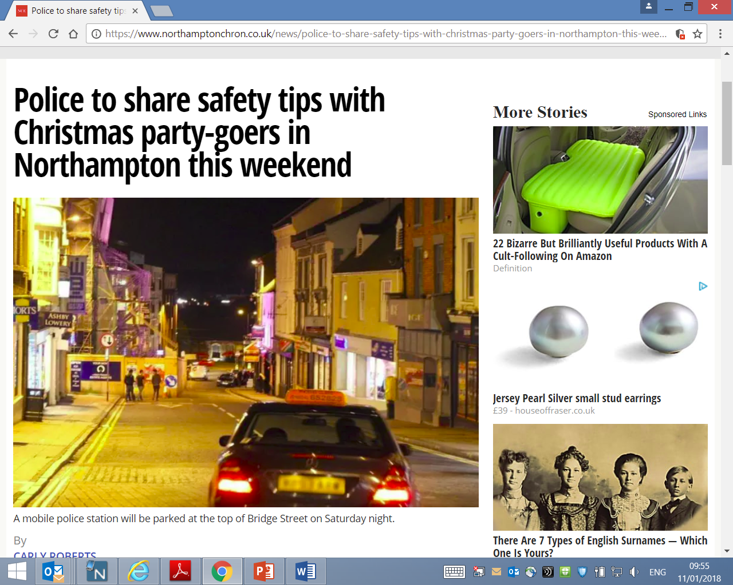
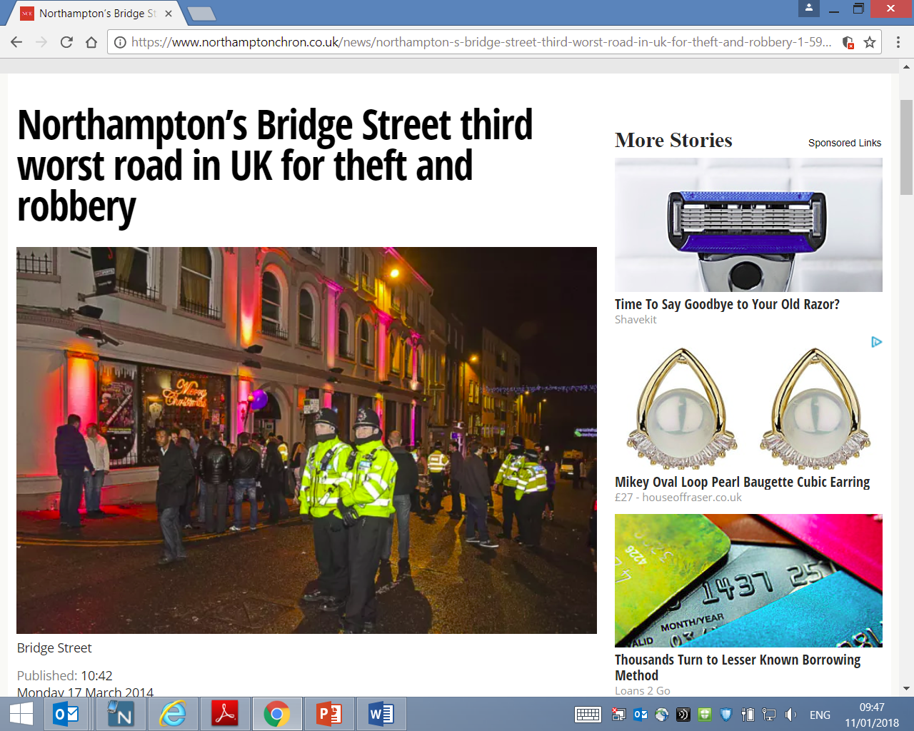
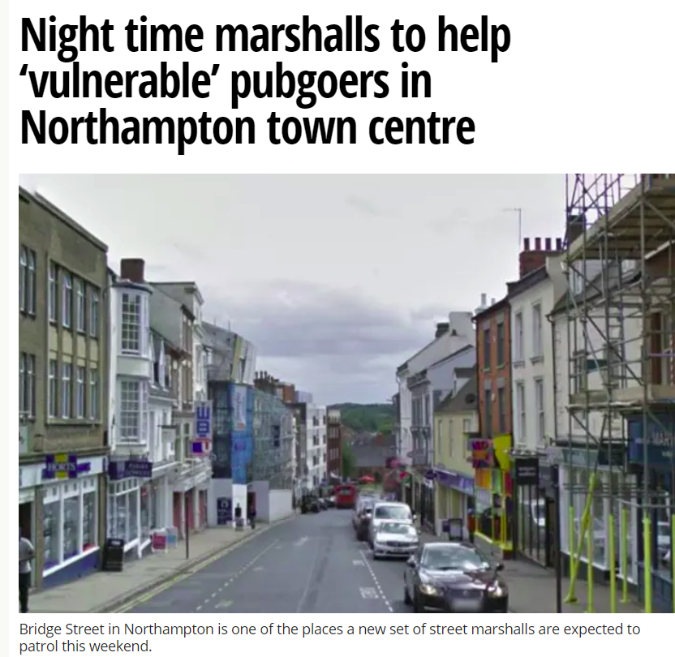
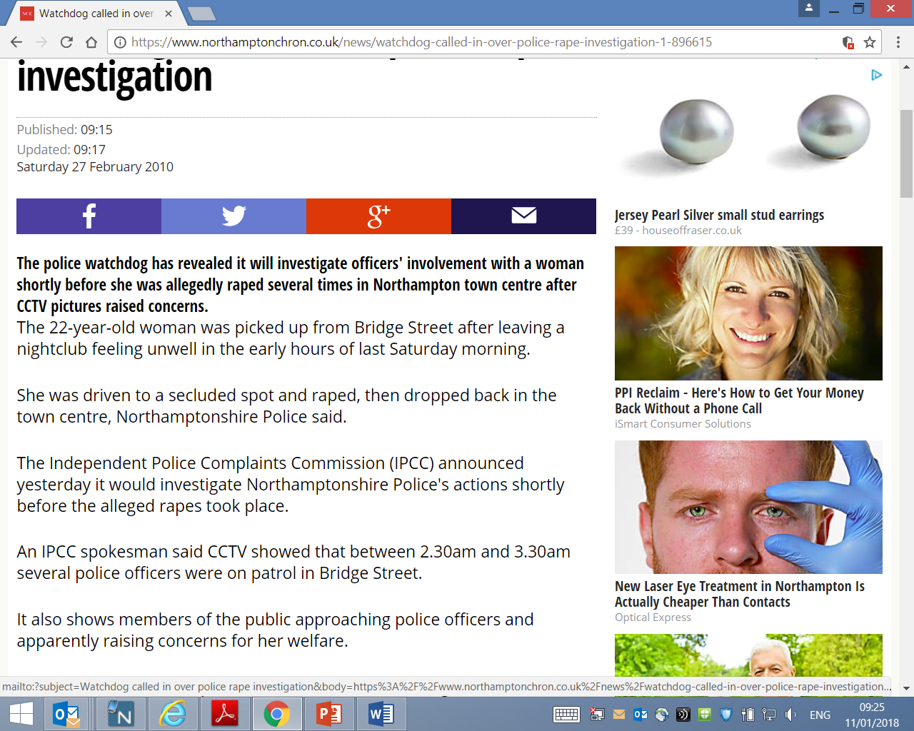
The Northampton Perspective

Slide 35
The Northampton - A timeline
OCTOBER 2008 – NORTHAMPTON STREET PASTORS
FEBRUARY 2010 – BRIDGE STREET NORTHAMPTON
MARCH 2013 – VULNERABILITY TRAINING ROLLED OUT – Officers and Door Staff
SEPTEMBER 2015 – VULNERABILITY TRAINING EXPANDED TO BAR STAFF.
JANUARY 2016 – INDIA CHIPCHASE
MARCH 2016 – CUSTOMER WELFARE STAFF USED FOR THE FIRST TIME IN A VENUE
MAY 2017 – UNIVERSITY STREET MARSHALLS SCHEME – THE OUTLINE
SEPTEMBER 2018- THE RELOCATION OF THE UNIVERSITY OF NORTHAMPTON
2018? – THE NORTHAMPTON VULNERABILITY AND SAFEGUARDING CENTRE

Slide 36
WE NEED TO WORK TOGETHER TO THE COMMON ADVANTAGE OF ALL THE AGENCIES INVOLVED IN EVERY KIND OF SAFEGUARDING AND, AT THE SAME TIME, WE TACKLE DEEP AND PERSISTENT DRUNKENNESS, ALL THE BETTER FOR SEEING IT FOR WHAT IT OFTEN IS, SOMETHING WHICH PEOPLE NEED HELP WELL BEYOND A PLACE TO CRASH OUT.
Dame Vera Baird QC
SAFE HAVENS Vs DRUNK TANKS and the importance of partnership working in the NTE

Slide 37
Northampton Vulnerability Centre (Proposed)
HOSTED BY BUT INDEPENDENT OF THE STUDENT UNION FOR NORTHAMPTON UNIVERSITY
STAFFED BY POLICE BETWEEN 22:00-05:00HRS ON FRIDAY, SATURDAY AND BANK NIGHTS
STAFFED BY NHS AND PARAMEDIC STAFF ON PEAK DEMAND DATES
A GEOGRAPHICALLY CENTRAL BASE FOR OTHER AGENCIES TO WORK FROM IN AND AROUND THE NTE – STREET PASTORS, OUTREACH WORKERS ETC
PROVIDING VICTIMS OF CRIME WITH EARLY ACCESS TO POLICE
PROVIDING A SAFE ENVIRONMENT FOR PEOPLE WHO ARE VULNERABLE
PROVIDING LOW LEVEL URGENT CARE WITHOUT THE NEED TO GO TO A+E

Slide 38
Northampton University Street Angels
Designed to provide the same service as Street Pastor’s but during the week on peak student nights.
A measure designed as a response to the increased student population midweek as of January 2018 and ahead of a campus move in September 2018.
Recognising the reduced police resources in the NTE midweek.
Providing a vulnerability response that will link the NTE venues and the student halls of residents by using the Angels effective.
Funded by the University with training from the Police and Street Pastor’s.

Slide 39
THE KEY FACTORS to success
EARLY IDENTIFICATION OF KEY PARTNERS
COMPLETE ENGAGEMENT FROM ALL KEY PARTNERS WITH A TRULY PARTNERSHIP APPROACH
SECURING FUNDING THAT IS SUSTAINABLE NOT JUST FOR THE SHORT TERM.
LOCATION, LOCATION, LOCATION.
COMMITMENT TO STAFFING
PUBLICISING SERVICES WHILE ESTABLISHING FIRM RULES OF ENGAGEMENT AND REFERRAL

Slide 40
Questions?
Jo
Twitter: @NTEconomy or @jocoxbrown
Web: www.nighttimeeconomy.com
Mobile: 07734255807
Email: jo@nighttimeeconomy.com
Chris
Mobile: 07557778816
Email: chris.stevens@northants.pnn.police.uk

